Slide 1
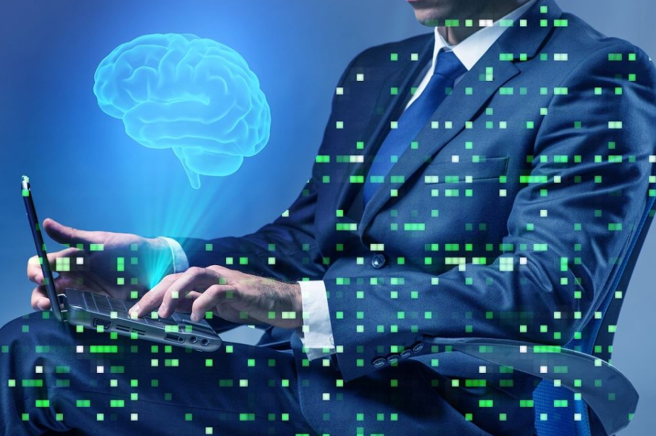
DATA 698
Capstone Senior
Research Project
Opening Lecture
Monday, Jan 31, 2022
Arthur J. O’Connor, Doctorate of Professional Studies
Academic Director, MS in Data Science and BS in Information Systems

Slide 2
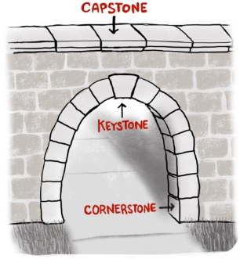
What is the Capstone?
Like the finishing stone of a structure, the Capstone or Senior Research Project represents your opportunity to apply what you’ve collectively learned in the Data Science program to a real-world problem or issue that is of professional or personal interest to you.
Much like independent study, you choose a topic to research, subject to the instructor’s approval. After you email your draft of your proposal to the instructor, the instructor will respond by either
Approve your proposal on its initial submission, or
Request revisions based on a general assessment of the work and/or specific feedback such as questions, comments, suggested changes
Process repeats for the mid-term as well as for final drafts.
Result: Project which you might want to:
Submit for publication in a journal or personal website
Post on a social media such as LinkedIn or FaceBook
Upload to a code repository such as GitHub or Bitbucket
…to serve as a sample of your work and/or expertise for potential employers or colleagues in your personal or professional networks

Slide 3
How Is It Different From Your Other Courses?
1. No standard lesson plan or tests. Each student typically works on her/his own topic, thus each research project is different. There are no common lesson plan, tests, quizzes or exams
2. Feedback is different from grading. In most courses, the primary indicators of student performance are grades. In this course, you can request and receive feedback on your proposals and drafts multiple times.
In fact, there are only two points at which you’ll be graded: at mid-term, you will receive a letter grade on the quality of your submitted work, and at the end of the course, you will receive a cumulative grade for your collective performance – based on your proposal, mid-term draft, final project paper and presentation
3. Primary learning outcomes: developing the ability to critically analyze an issue or phenomenon, develop a statistical model or machine learning technique to measure and/or solve it, and articulate your findings clearly, concisely and succinctly.

Slide 4
How Do You Write a Research Paper?
In producing a quantitative research paper, you need to:
Identify a problem or phenomenon and frame it in as a function of a number of factors
Develop a hypothesis or research question that proposes a relationship to variables inherent to that problem or phenomenon
Explore and identify data sets to create variables that represent these factors, as well as statistical and/or machine learning method(s) to model (measure and/or predict) this phenomenon
Design and implement a model or set of models to measure or explore these relationships
Interpret, develop and formulate/articulate conclusions from the results

Slide 5
How Is It Structured?
Papers vary a bit in format, but most follow this same general outline/flow:
Abstract: a short (100 to 150 words) synopsis of what the research explored, its findings, and their significance. Note: this is a last section you write, after you’ve completed writing the rest of the paper.
Introduction: The introduction should familiarize your reader with what you are trying to show, as well as the reasons for your research and what value you believe that it has.
Literature Review: This section analyzes any reading or documents that were used in your analysis. By reading previous studies on your topic, you can assess what variables or methods might be useful for your research.
Research Question and/or Hypothesis: This describes what problem you’re seeking to examine, phenomenon you want to explore or effect that you want to measure in the study.
Data and Variables: This section describes what data you intend to use, how they were acquired, and how they represent the variables you have chosen.
Statistical Methods: This section describes the methods you used to analyze the data.
Discussion of Results: In this section, you describe the results of your statistical analyses, their significance, and how they compare or contrast with those from other studies.
Conclusion: This section summarizes your final thoughts on your findings and what they show, as well as disclose limitations to the study and suggest future avenues for research.

Slide 6
What’s the Course Schedule? What you need to do, by when
Weeks 1 to 3
Weeks 10 to 12
Weeks 13 to 14/15
Week 4
Weeks 5 to 8
Week 9
Three, Iterative Phases
Proposal
Weeks 1 to 3: Develop Your Proposal
Week 4: Final Review/Approval of Proposal
Mid-Term Draft
Weeks 5 to 8: Develop Mid-Term Draft of Research Paper
Week 9: Final Review/Approval of Mid-Term Draft & Mid-Term Grade
Final Draft
Weeks 10 to 12: Finalization of Research Paper
Weeks 13 and 14/15: Project Presentation & Final Grade

Slide 7
What’s the Schedule? What you need to do, by when
Weeks 1 to 3
Weeks 10 to 12
Weeks 13 to 14/15
Week 4
Weeks 5 to 8
Week 9
Weeks 1 to 3: Develop Your Proposal
You will choose a topic by developing and submitting a short (no less than 3-page) proposal of their research project, which must be approved by the Instructor. This proposal should include a clear and concise articulation of:
What problem/issue/phenomenon you have chosen to explore – research question(s), theory and hypotheses – and why it is important, significant or meaningful
What prior research has been done on the topic: explain originality of your research [note: just a few paragraphs on relevant areas of research, not a detailed literature review]
What research methods you intend to use; what models, variables and data sets will be used to test hypos and theory
How results will be measured and evaluated
On or before Week 3, you will e-mail you proposal draft to your instructor, who will review and provide feedback on the proposal, either accepting it immediately or responding with comments requiring more revision to/work on it.
In evaluating the proposal for approval, the Instructor will assess:
Clarity and specificity of the proposed research topic
Sufficiency of scope and complexity of the issue and proposed analysis
Availability and statistical validity of the data sets and model(s)
…to help ensure that the project meets basic requirements and can be completed within the semester timeframe.

Slide 8
What’s the Schedule? What you need to do, by when
Weeks 1 to 3
Weeks 10 to 12
Weeks 13 to 14/15
Week 4
Weeks 5 to 8
Week 9
Week 4: Final Review/Approval of Proposal
Final proposal drafts are required to be medium length of no less than 3 pages in length.
Papers should be prepared in Microsoft Word format (so that the instructor can provide feedback via the “Track Changes” feature.
Text should be Times New Roman, 12 point font.

Slide 9
What’s the Schedule? What do I need to do, and by when?
Weeks 1 to 3
Weeks 10 to 12
Weeks 13 to 14/15
Week 4
Weeks 5 to 8
Week 9
Weeks 5 to 8: Develop Mid-Term Draft
Working from the proposal, you begin fleshing out the first sections of the research paper: the Introduction, Literature Review, Hypothesis, Data and Variables and Statistical Methods.
You will draft a medium length (no less than 10-12 pages) paper representing the first half of your research study, which will form the basis of the mid-term letter grade in Blackboard Grade Center.
On or before Week 8, you will e-mail your mid-term draft to your instructor, who will review and provide feedback on the proposal, either accepting it immediately or responding with comments requiring more revision to/work on it.

Slide 10
What’s the Schedule? What you need to do, by when
Weeks 1 to 3
Weeks 10 to 12
Weeks 13 to 14/15
Week 4
Weeks 5 to 8
Week 9
Week 9: Final Review/Approval of Mid-Term Draft & Mid-Term Grade
You will finalize your mid-term draft, which will represent the first five sections of your research study: Introduction, Literature Review, Hypothesis, Data and Variables and Statistical Methods
Draft will form the basis of the mid-term letter grade in Blackboard Grade Center.

Slide 11
What’s the Schedule? What you need to do, by when
Weeks 1 to 3
Weeks 10 to 12
Weeks 13 to 14/15
Week 4
Weeks 5 to 8
Week 9
Weeks 10 to 12: Finalize of Full/Final Draft of Research Paper
You will devote the balance of the course on data collection, tweaking and re-running the models, as well as drafting the remaining sections of the research paper (Findings, Discussion, Conclusion, and the Abstract), and finalizing the full paper for presentation and final submission.
On or before Week 12, you will e-mail your final draft to your instructor, who will review and provide feedback on the proposal, either accepting it immediately or responding with comments requiring more revision to/work on it.

Slide 12
What’s the Schedule? What you need to do, by when
Weeks 1 to 3
Weeks 10 to 12
Weeks 13 to 14/15
Week 4
Weeks 5 to 8
Week 9
Weeks 13 to 14/15: Final Project Presentations
Within the last two weeks of the class you will have 15-20 minutes to present your research.
Presentations don’t require the polished delivery and high production values of a TED Talk, but you are expected to be fully prepared to be concise and hit the highlights/key messages. While some students produce materials (such as Power Point slides) specifically for their final presentation, such additional materials are not required.
In terms of audience, presenters should assume an audience of peers as well as non-technical management. The focus should be on what the research is about and what the results actually mean or reveal, but speakers should also be prepared to respond to technical questions about methodology, if they arise.
Note: you have the option to present their final project during a weekly lecture class, or simply email link to a recorded video of your presentation to the instructor.

Slide 13
How Will You Be Graded?
Given the iterative process of designing, developing and producing a research paper – and unlike other courses in the MSDS program – there are multiple opportunities during in the course for students to solicit feedback on their work product from the instructor, but only two of which students will be formally graded:
At mid-term, you will receive a letter grade on the quality of your submitted work;
At the end of the course, you will receive a cumulative grade for your collective performance, based on your proposal, mid-term draft, final project paper and presentation
Grades are given on a letter basis (A, B, C, etc.). Given that each student’s research project is different, and the lack of tests, quizzes or exams in the senior research project course, there are no numerical scores or grade weightings; thus, there is no point scale or rubric to convert numerical scores to letter grades.
In the absence of hard/quantitative measures to assess the quality of a research paper, students must rely on the direction and feedback they receive from their instructor/advisor.
Two types of evaluation criteria: general and domain-specific

Slide 14
What Criteria Are Used? General Criteria
The following criteria will be used to grade the overall quality of your senior research paper:
Significance and Originality of the Topic
Does your topic represent or address an interesting issue? Will the results have a practical application to a real-world business or social problem?
Does your research borrow from, or represent a slight variation to, an existing study (perhaps a Kaggle competition)? Or are you designing and creating your own variables based on a novel combination of data sets?
Quality and Sophistication of Analyses
Do the statistical methods selected accurately test or measure the research question or hypotheses proposed (i.e., quality model design)?
Do the data sets and variables based them accurately capture/reflect the phenomenon being explored (i.e., does the research study have internal validity)? In this model designed so that the results can be recreated/generalized/applied to other/similar cases (i.e., does the research study have external validity)?
Does the analysis entail simple descriptive statistics, or does it involve complex classification, regression, or clustering algorithms (sufficient for a data science masters’ thesis)?
Quality of Writing
Is the final draft in final form (no errors in spelling, grammar, diction, formatting or citations)?
Does the nature and scope of the research, the design of the analyses, the results and the significance of result clearly and concisely explained in simple, compelling language?

Slide 15
What Criteria Are Used? Domain-Specific Criteria
The second set of quality descriptors apply to specific sections or domains to help differentiate what is considered “Accomplished” vs. “Proficient” vs. “Needs Improvement.”
DOMAIN | ACCOMPLISHED | PROFICIENT | NEEDS IMPROVEMENT
Introduction | The research question is clearly stated, can be answered by the data, and the context of the problem clearly explained. | The research question is unclear and/or not supported by the data. | Research question is ambiguous, unclear, or not stated.
Data Display | Includes appropriate, well-labeled, accurate displays (graphs and tables) of the data. | Includes appropriate, accurate displays of the data. | Includes appropriate but no accurate displays of the data.
Data Analysis | The appropriate statistical test(s) was used for the data and interpretation was clear. | The appropriate statistical test(s) was used but interpretation was not fully clear or well-articulated. | The incorrect statistical test was used and/or not justified for the data as presented.
Conclusion | Conclusion includes a clear answer to the statistical question that is consistent with the data analysis and the method of data collection. | Conclusion includes an answer to the statistical question that is consistent with the data but not with the data collection method. | Conclusion does not include an answer to the statistical question that is consistent with the data analysis.
Final Presentation | Speaker articulates the nature of the research and shows the study’s findings clearly, concisely and succinctly | Speaker hits most of the highlights | Speaker does not clearly and concisely explain the nature of the research project nor its findings.

Slide 16
Useful Tips: Planning
In selecting a research topic, choose a topic of domain expertise or experience.
Students with familiarity of the topic’s subject matter often find in much easier to accurately identify meaningful issues and design the research – as well as express themselves clearly and concisely – than those who do not.
Make sure there are data sets available and accessible to use in your model that accurately present the variables you intend to use in our research.
It’s relatively easy to identify interesting topics; the trick is to identify those that can be measured and tested via statistical means.
Key to getting your proposal approved is demonstrating that you’ve validated that there are data sets you can use to measure the hypothesis you want to test.
You don’t want to invest a lot of time and energy developing a proposal – only to discover that you can’t conduct the analysis required for the rest of the research paper.
Plan out your work and budget your time.
For the mid-term draft, focus on finalizing the Title, Introduction, Literature Review, Hypotheses, and Data and Methods sections. For the balance of the semester, focus on the most time-consuming aspect of most quantitative research projects (data acquisition/wrangling).
After conducting how exploratory analysis and fine-tuning your models, draft your Discussion of Results, Conclusion, and lastly, the Abstract.

Slide 17
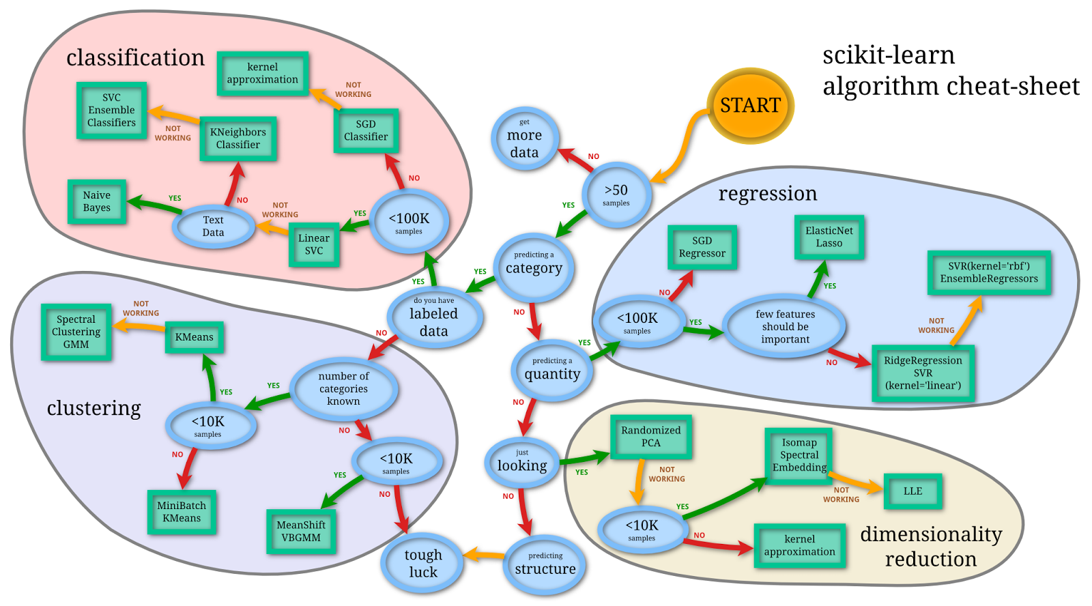
Useful Tips: Selecting Model Type
Regression: predict an outcome, based on its past performance
Classification: identify what classes new observations belong, based on results of a training set of data containing observations (or instances) whose category membership traits are known
Clustering: determine which observations belong to which group, based on their similarities to those in other groups
Dimensionality reduction: simplify the dimensions of a feature set to improve accuracy and reduce noise in the data

Slide 18
Q&A/Discussion
Capstone
Senior Research Project

